Slide 1
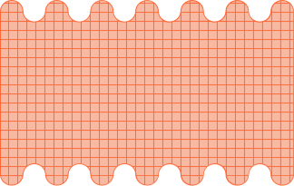




AMIA 2023
S-VHS &
S-VIDEO
SUPER, OR SUPERCILIOUS?
Presentation By:
Morgan Oscar Morel
Video Lab Supervisor
Library of Congress

Slide 2

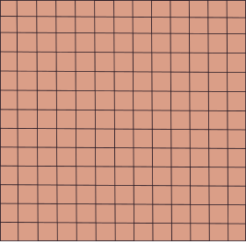
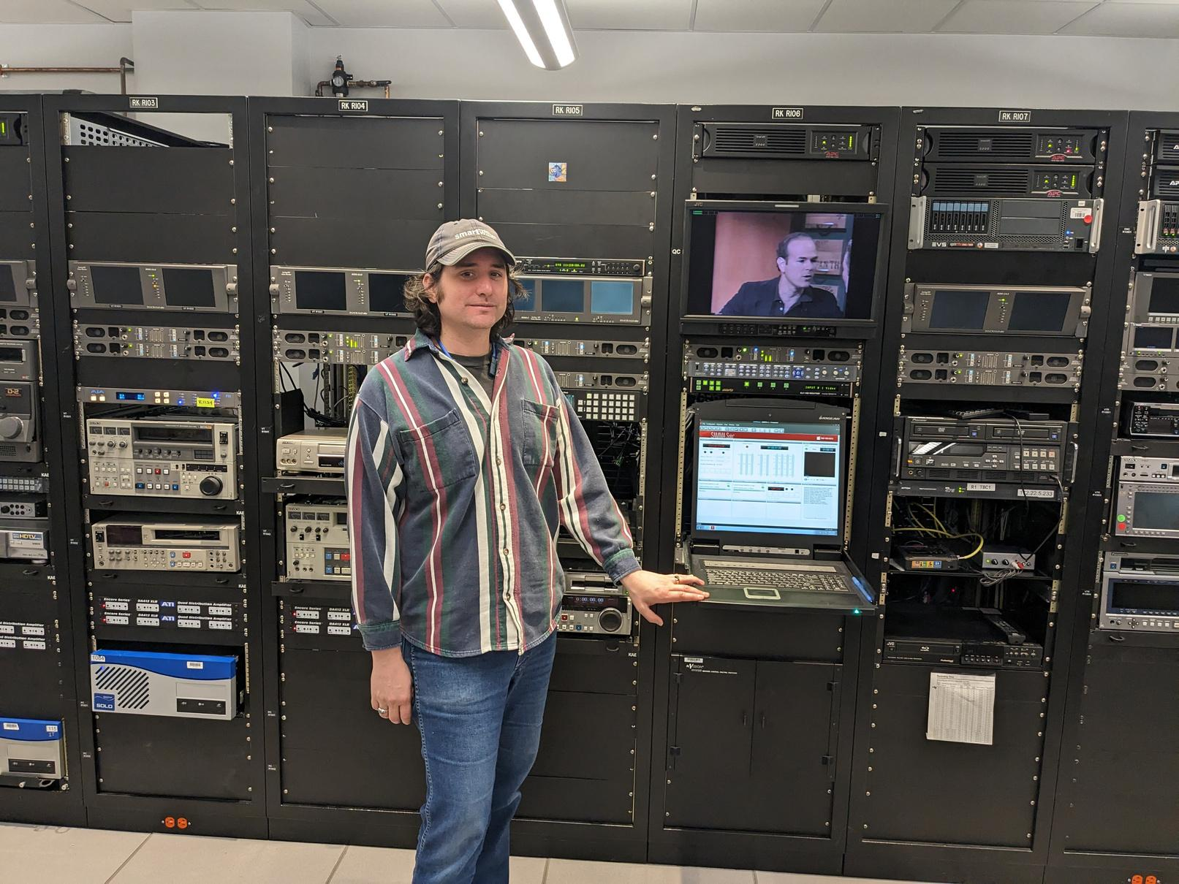

MORGAN MOREL
Video Lab Supervisor at Library of Congress
National Audiovisual Conservation Center
Notes:
Hi eveyone. My name is Morgan Morel, I'm currently the Video Lab Supervisor at the Library of Congress's National Audiovisual Conservation Center in Culpeper, Virginia. He's me the videol lab, where we made a bunch of the tests files i'll talk about later.

Slide 3




TOPICS COVERED
1
DEFINITION OF S-VHS, S-VIDEO, AND RELATED CONCEPTS
2
PERFORMING TESTS TO DETERMINE QUALITY DIFFERENCES
3
APPLYING THIS INFORMATION IN AN ARCHIVAL PRESEVATION CONTEXT
Notes:
Before getting started I want to go over what will be discussed in this presentation.
First, I'll do an overview of SVHS, S-Video, and related concepts. There's a few geeky technical concepts discussed here, but I'll try and keep it light.
Next, I'll discuss a few tests I performed to determine quality difference in formats and transmission modes.
Lastly, I'll go over how this all applies to video preservation.

Slide 4
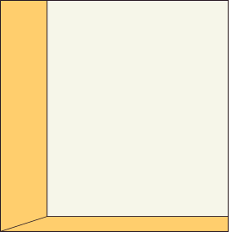
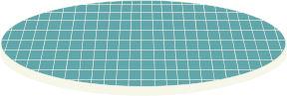


PART 1
DEFINITIONS
(WHAT IS THIS STUFF?)
Notes:
First, let's talk about what all this stuff is.

Slide 5

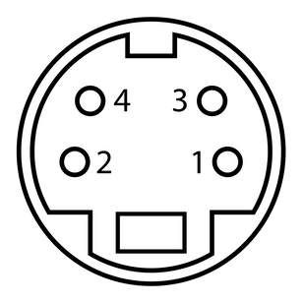
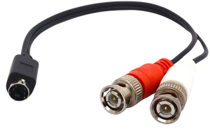
DEFINITIONS
S-Video
A videtotape recording format
A video signal transmission format
Stands for Super VHS
Stands for Separate Video (not super!)
Improved version of VHS Format
Improves artifacts inherent to composite video by allowing for the processing of Luma and Chroma separately
Increased resolution from increased luminance bandwidth. Color is not improved
Cassette shells are nearly identical to VHS, with a detection hole punched in the bottom
Can use the 4 pin DIN connector
Or two BNC cables
Notes:
So first, I want discuss SVHS and S-Video.
SVHS is a videotape recording format, essentially an improved version of VHS, with the S standing for SUPER. S-VHS offers improved resolution over VHS from increased luminance bandwidth. however, the color quality of S-VHS is not improved over VHS.
S-Video is a video signal transmission format, which sends the luma and chroma of a video signal separately. Hence the S stands for Separate (not super). This separated color transmission improved artifacts that are inherent to composite video transmission.
The confusion between the two may come from the fact that S-Video connections were first included on SVHS decks, like the JVC HR-S7000 which was released in 1987

Slide 6
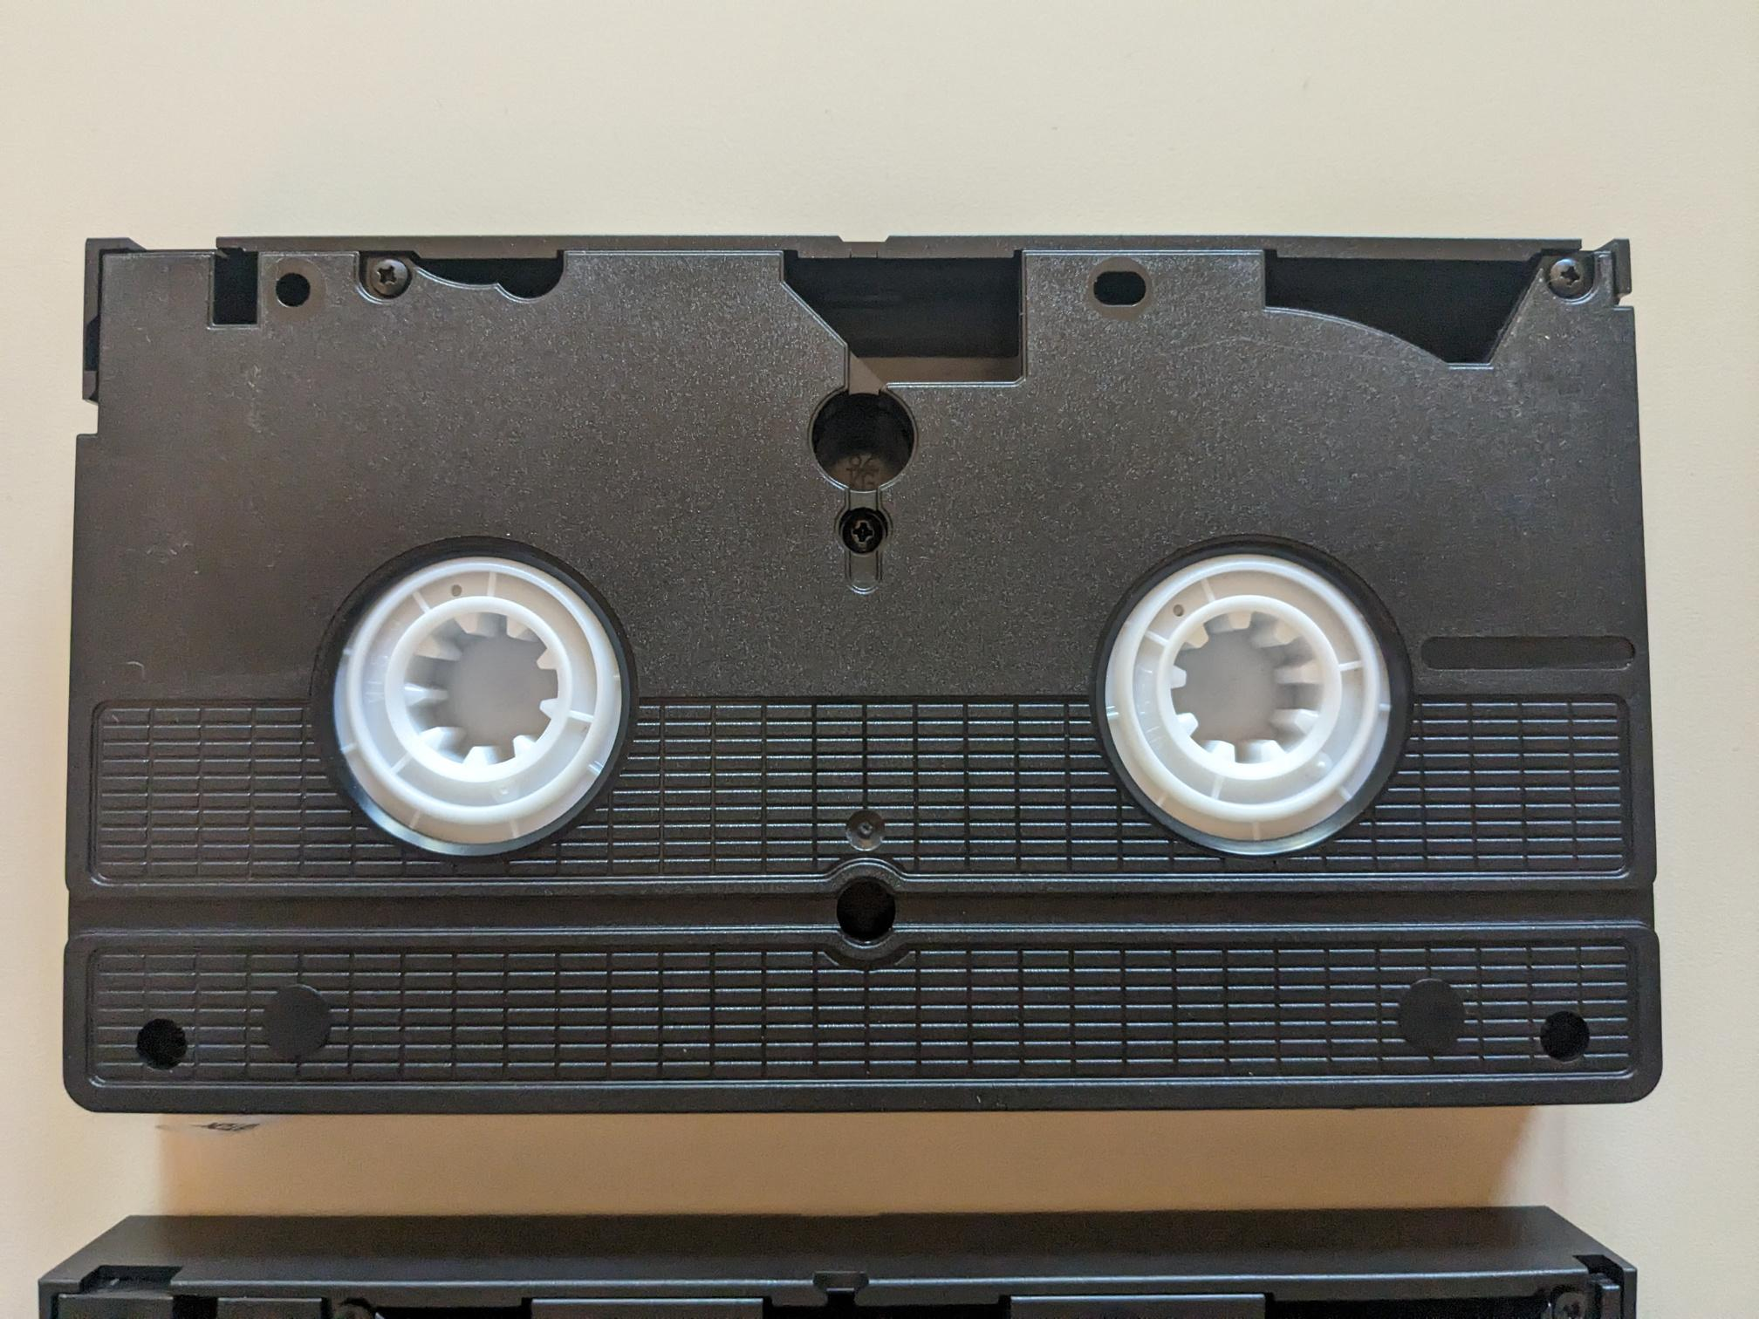
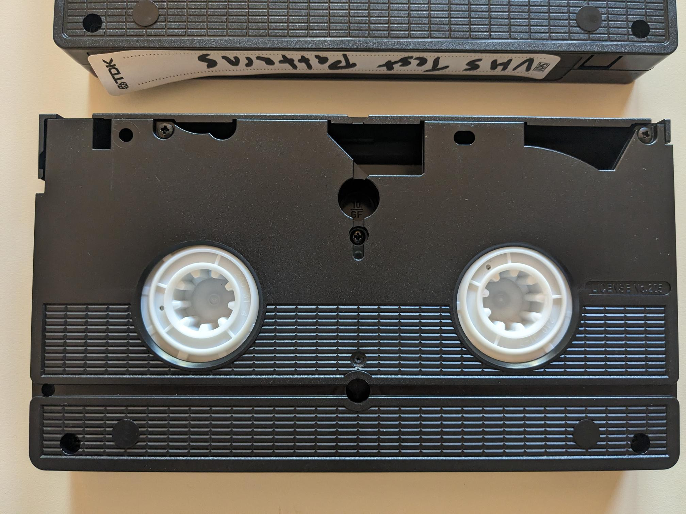
S-VHS & VHS
Notes:
SVHS and VHS tape are distinguished be a small hole on the bottom of SVHS tapes. SVHS enable decks have a sensor that uses this hole to determine which type of tape has been loaded in.
However, it's possible to record a VHS signal on an SVHS tape

Slide 7
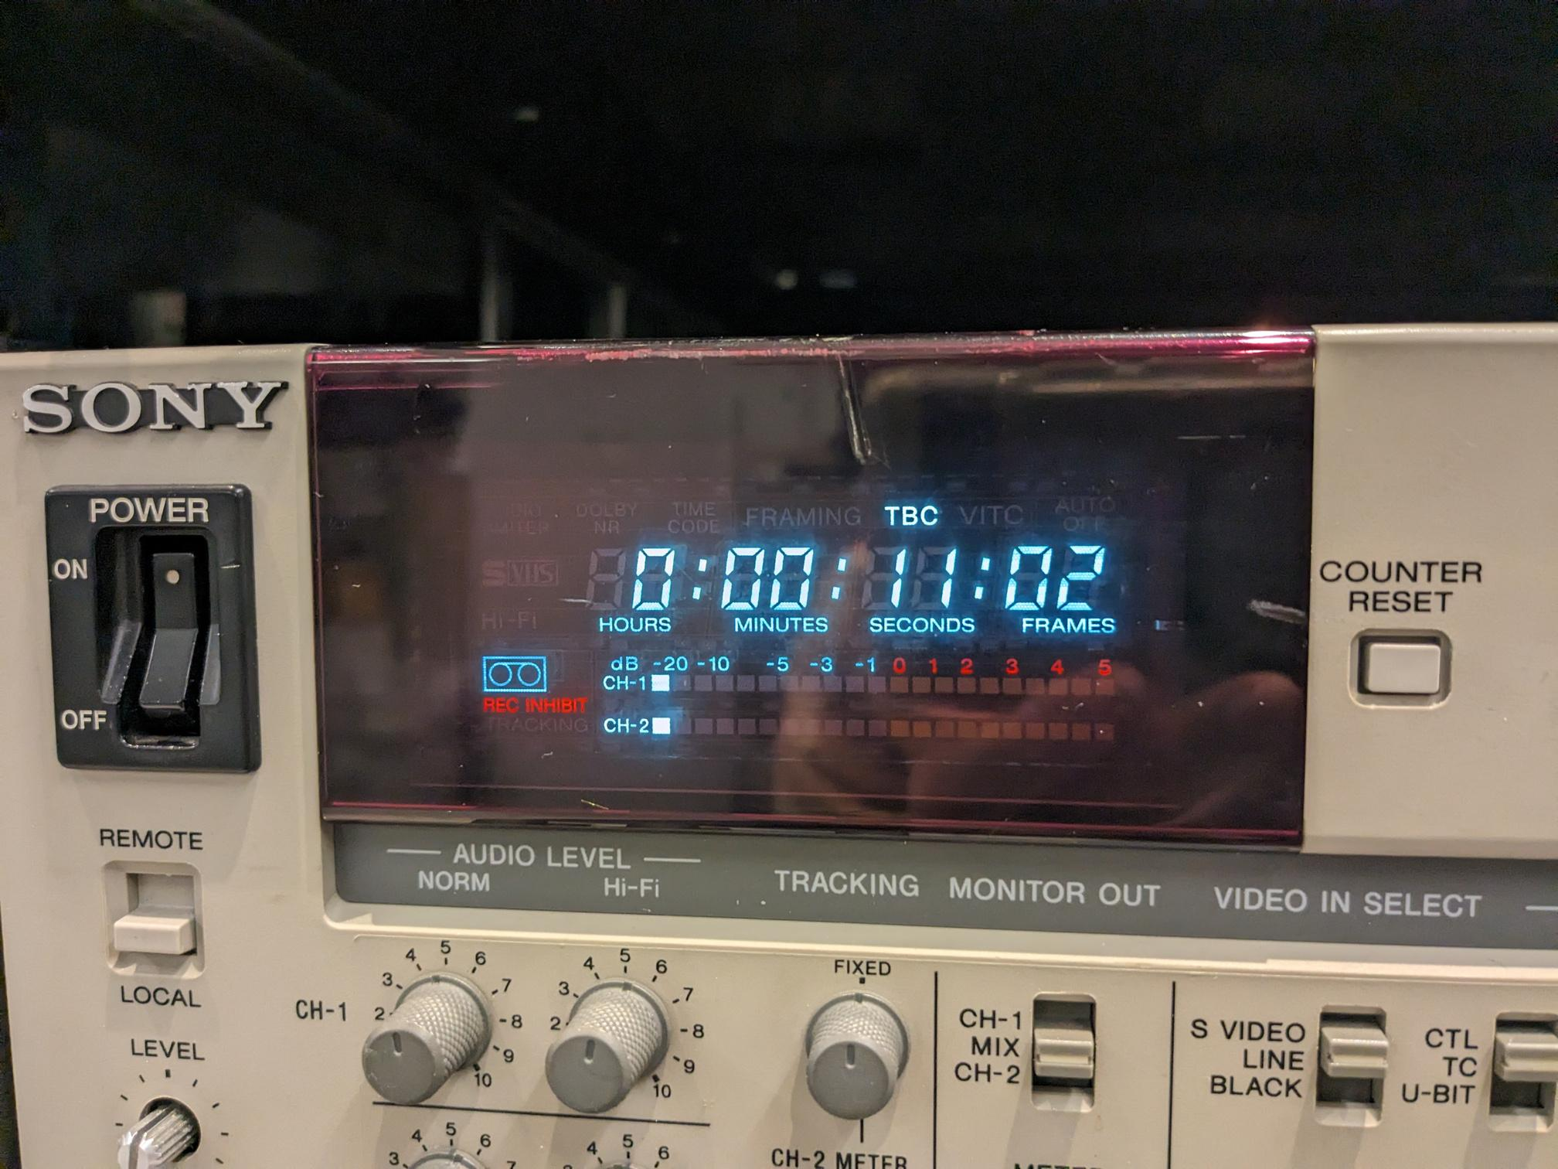
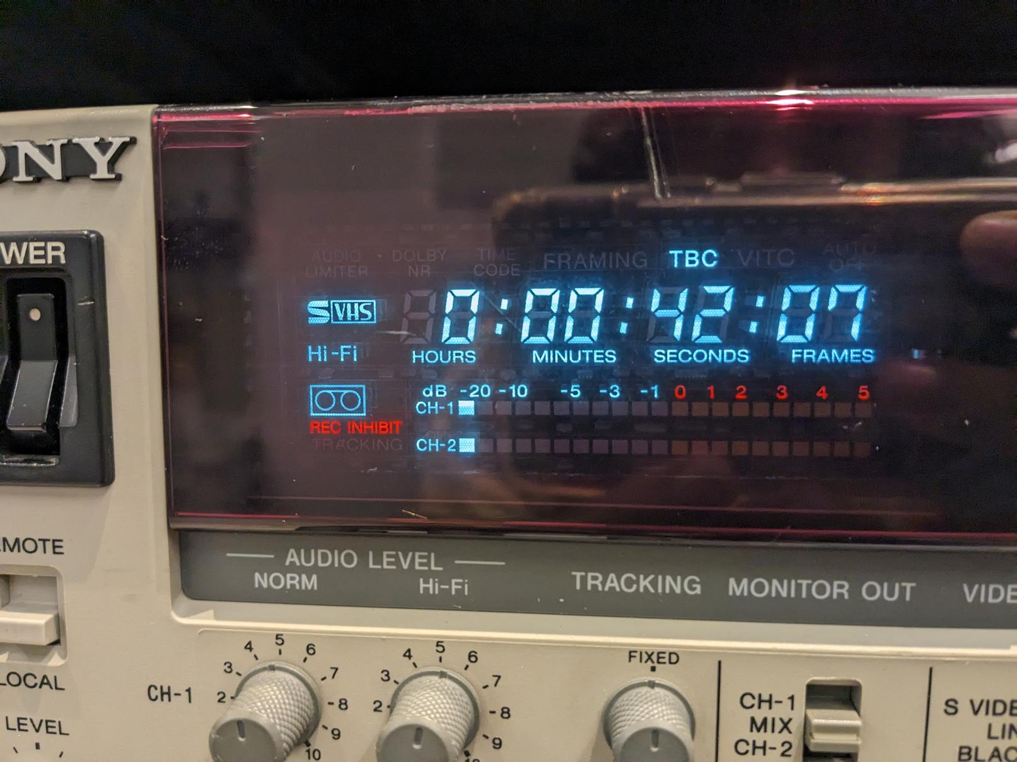
S-VHS & VHS
Notes:
That's where the indicator light comes in. The Sony SVO-5800 has an indicated that will turn on if an SVHS signal is detected on the tape, that way you know for sure whether the content is actually SVHS.
You'll need to consult the manual for your deck if you want to know for certain whether the indicator light is detecting the cassette hole, or the actual video signal.

Slide 8

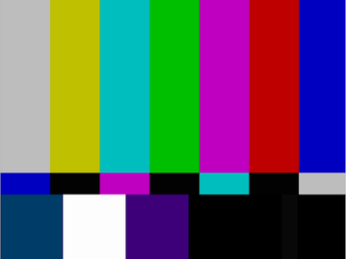

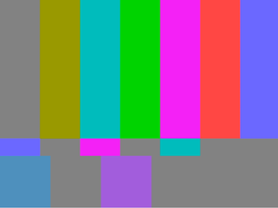
DEFINITIONS
Luminance
(Luma)
Chrominance
(Chroma)
The brightness or brilliance of the video signal
The color information of a picture
Edges and details of an image depend on properly resolved luma
The color information is often downconverted (heterodyned) to a much smaller bandwidth than luma
Most of the bandwidth of a video signal is devoted to the luma
Notes:
Moving on, I'll now get into deeper discussion of concepts that will help make sense of why SVHS and S-video were such important technological advances.
Luminance and Chrominance, often referred to as Luma and Chroma, are the Brightness and Color portions of the video signal, respectively.
The edges and details of an image mostly depend on the luminance, because our eyes are much better at detecting shades of black and white than they are at detecting color. As a result, most of the bandwidth of a video signal is devoted to the luma, while chroma is given only a portion of the signal's bandwidth.
Below, you can see what the luma and chroma portions of SMPTE bars look like on their own.

Slide 9


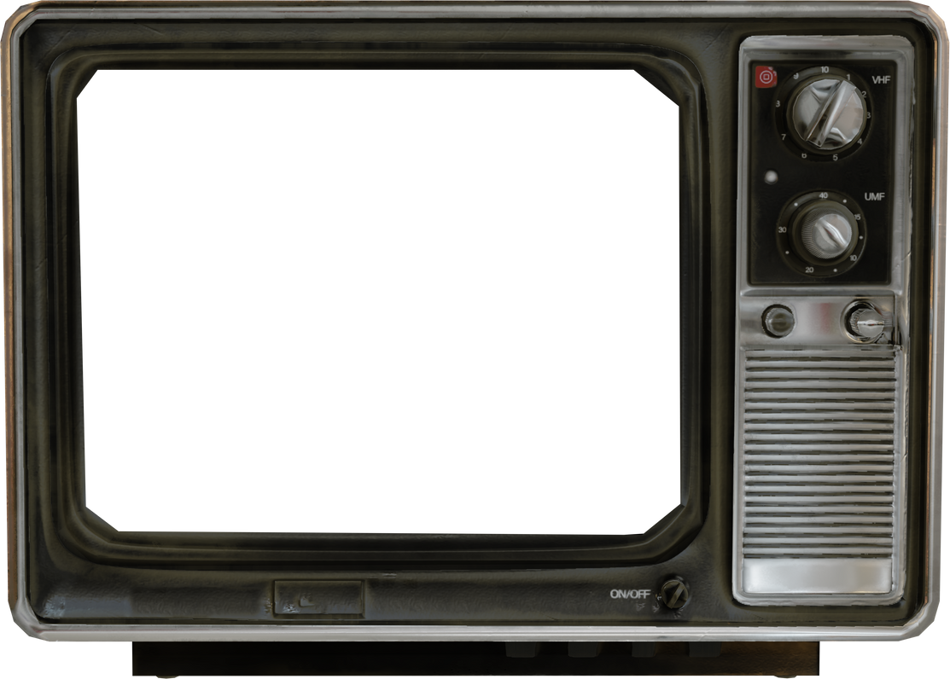
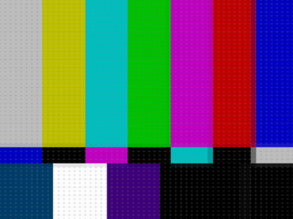

COMPOSITE TRANSMISSION
Notch Filter
Band Pass Filter
Notes:
When using a composite cable to transmit video, the luma and chroma have to be separated using a notch and band pass filter. These filters can introduce artifacts, especially when inexpensive components are used.

Slide 10
S-VIDEO TRANSMISSION
Notes:
On the other hand, S-video allows the luma and chroma to be transmitted separately, avoiding the need for additional processing

Slide 11
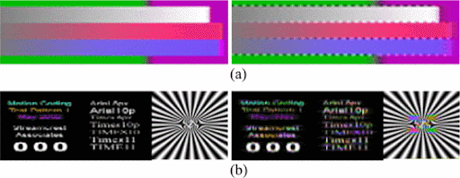
COMPOSITE ARTIFACTS
Dot Crawl
Cross Luma
Rainbow Effect
Cross Color
Occurs at sharp transition between saturated colors
Occurs near sharp black or white edges and text.
Chroma information bleeds into luma frequencies
High frequency luma freqs bleed into chroma freqs
Notes:
This avoids the introduction of certain artifacts inherent to composite video transmission. These artifacts are called Dot Crawl, and Rainbow Effect, also known as Cross Luma and Cross Color respectively.
These artifacts are caused by frequencies from one portion of the video signal leaking into the frequencies of the other. for example, cross color is caused when tight black and white patterns cause the luma frequencies to be so high that they are read as chroma values
On the left you can see dot crawl as a checkerboard pattern that appears on the edges between the color bars
On the right you can see rainbows errors appearing in where the black and white patterns become tight.

Slide 12
RESOLUTION
Digital resolution is measured in Pixels
Analog resolution is measured in
Total Vertical Lines (TVL)
References to the “number of lines” a format can reproduce refers to TVL, not to pixel height, or scan lines
Notes:
Next I want to talk about resolution. This is going to get a little heady and may seem like a bit of a departure, but I really want to take this time to clear up some common misconceptions.
as you may know, digital resolution is measured in Pixels. Analog resolution, on the other hand, is measured in Total Vertical Lines, or TVL. This refers to how many alternating black and white lines can resolved in an analog picture
If you see literature written about the "number of lines" a format can reproduce, this refers to TVL, not the pixel height or number of scan lines. NTSC pictures ALWAYS have 486 active video scan lines, regardless of the resolution of the picture.

Slide 13
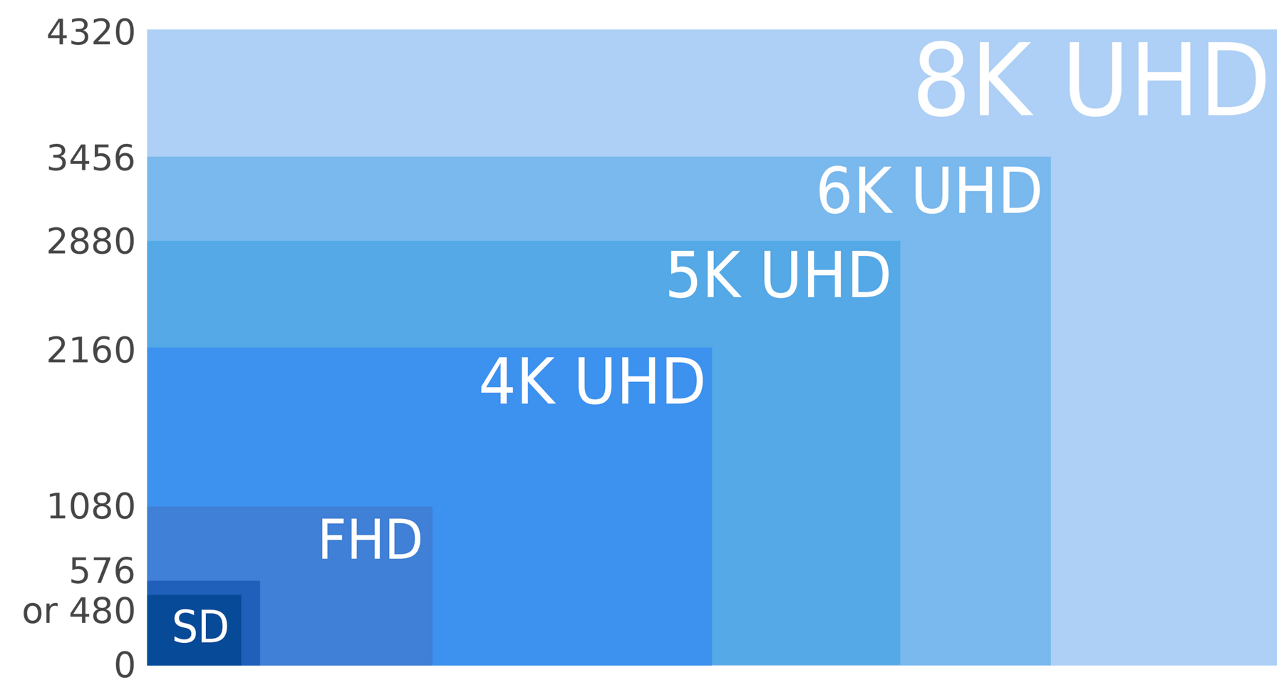
RESOLUTION
Digital resolution measured in Pixels
720 1920 3840 5120 6144 7680
Notes:
As I mentioned, digital resolution is measured in pixels.
As the resolution of a format increase, the size of the frame increases

Slide 14
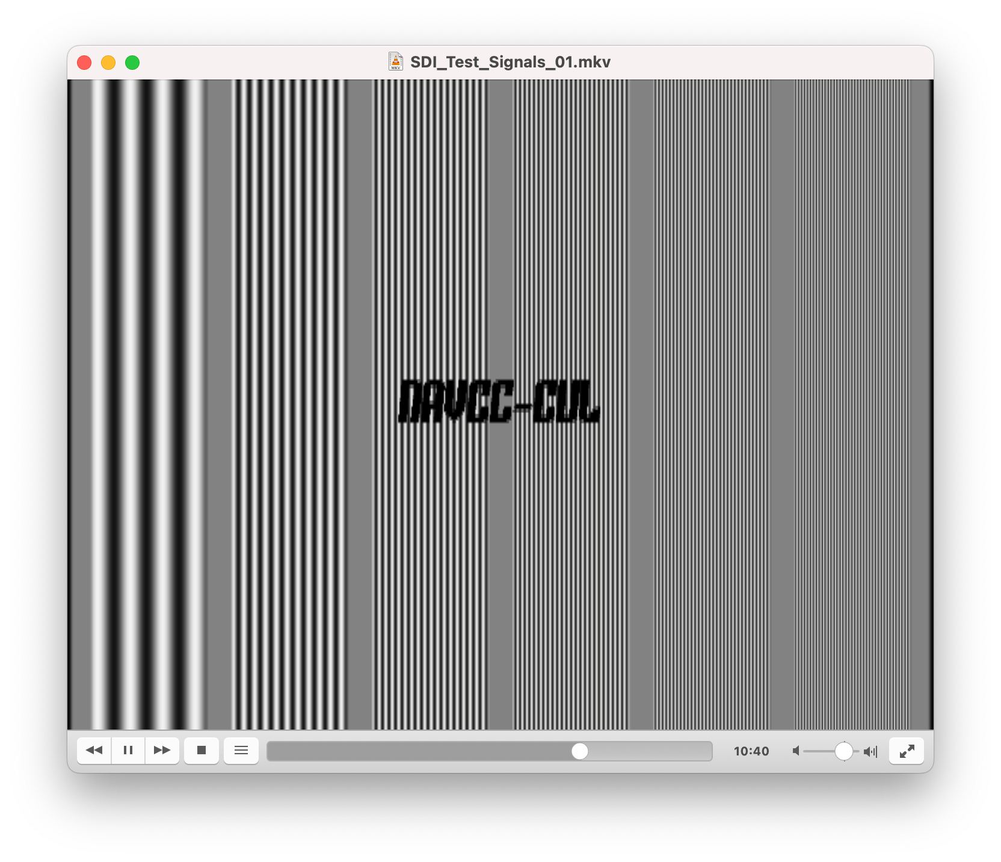
RESOLUTION
Analog resolution measured by how many Total Vertical Lines can be represented
40 TLV 120 TVL 160 TVL 240 TVL 288TVL
Notes:
However, in analog video the frame size is static. When the resolution increases, the format's ability to render more closely spaced black and white lines is increased

Slide 15

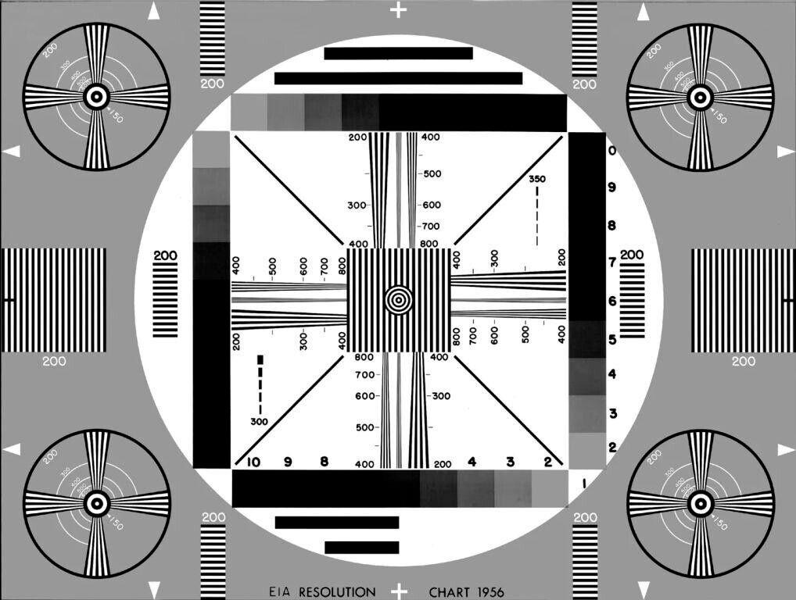
Notes:
TVL can be measured with this EIA-1956 resolution chart

Slide 16
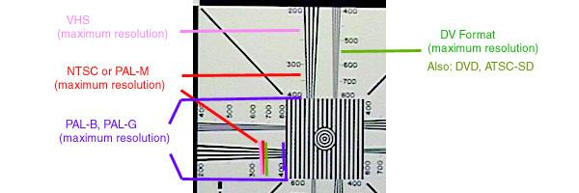
Notes:
If a format can reproduce 200 alternating black and white lines across a frame, then it is said to have a resolution of 200 TVL. Any details beyond that point would be lost to a blur.

Slide 17
RESOLUTION
(LP x tHA x BWs)
AR
(2 x 52.644 x 1)
1.33
TVL =
TVL =
tHA = 52 + (59/90) microseconds
BWs = Signal bandwidth (in MHz)
AR = Aspect Ration = 4:3 = 1.33
LP = Line pairs per cycle = 2
78.983 TVL per 1 MHz of bandwidth
https://www.causewaysecuritysolutions.com/resolution-calculated-tv-lines.html
Notes:
TVL can be calculated using the duration of a single scan line of video, the aspect ratio, and the bandwidth of the encoded video signal.
If you do the math, you'll find that you get about 79 TVL per 1MHz of bandwidth.

Slide 18
RESOLUTION
FORMAT | Broadcast NTSC | VHS | SVHS | U-matic | U-matic SP
TOTAL VERTICAL LINES | 336 | 240 | 420 | 250 | 330
TOTAL PICTURE HEIGHT | 448 | 320 | 560 | 333 | 440
LUMA CARRIER FREQUENCY | 4.25 MHz | 3.04 MHz | 5.03 MHz | 3.58 MHz | 4.2 MHz
Notes:
This might seem a bit abstract, but it help us to determine the theoretical resolution of certain formats if we have their bandwidths, or vice versa.
This also can help us understand just how much better SVHS is than VHS is, considering it has over 400 lines of resolution, vs VHS which has only 240 lines.

Slide 19
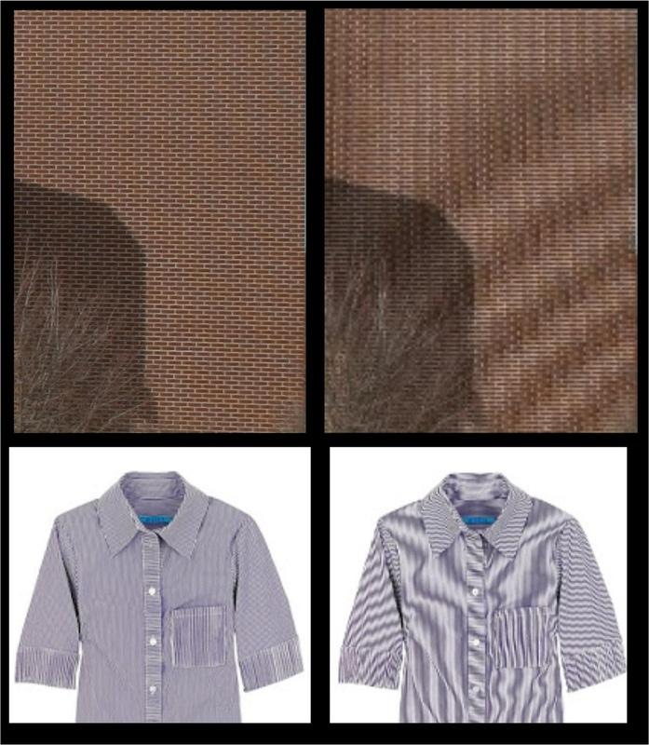
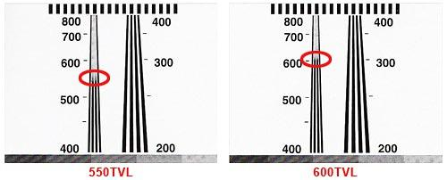
RESOLUTION ARTIFACTS
sd
Moiré
Lost Detail
Notes:
So what does this mean visually? Two common resolution artifacts are Moiré and Loss of Detail. Moiré interference looks like wavy patterns caused by tight patterns being improperly resolved. Loss of detail refers fine details being lost entirely if they are beyond the resolution threshold.
On the left you can see Moiré patterns appearing on the right side of the image, where the patterns in the bricks and the shirt are too tight to be properly resolved.
On the right, you can see that the black and white lines become blurred when they get too close to be properly resolved.

Slide 20
RECAP
S-VHS Improves analog resolution, but maintains same color quality as VHS
S-Video reduces cross luma and cross chroma errors by allowing transmitting luma and chroma separately.
Notes:
So to recap: SVHS has much improved analog resolution over VHS, but maintains the same color quality as VHS. This improved resolution makes it possible to see much finer details with SVHS.
S-Video on the other hand, reduces errors by transmitting Luma and Chroma separately, avoiding the need for notch and bandpass filters which introduce cross color and cross luma artifacts.

Slide 21


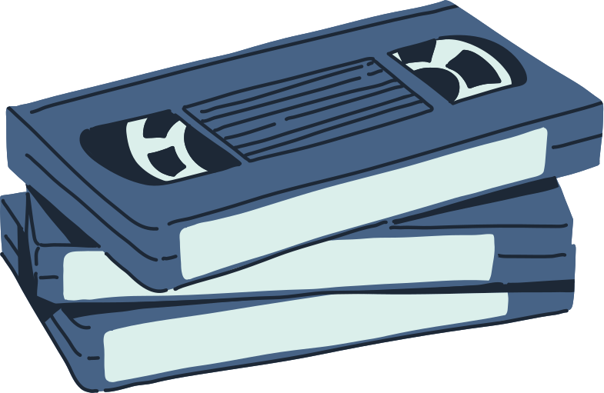
PART 2
QUALITY ANALYSIS
Notes:
Now, we'll move onto the experimental portion of this presentation!

Slide 22
EXPERIMENT
I wanted to compare the quality differences between different permutations of S-VHS and VHS recordings, along with using S-Video and Composite transmission
Notes:
With this experiment, I wanted to compare the quality differences between different permeutations of SVHS and VHS recordings, along with using S-Video and Composite transmission

Slide 23
METHODOLOGY
COMPARING RESULTS
Visual comparison: Compose videos in DaVinci Resolve to easily compare their resolution and any artifacts
Data Comparison: Look at the resulting file in QCTools. Analyze saturation and compression rates
Notes:
I compared the results using two methods, Visual comparison and Data Comparison.
For the visual comparison I made some composites using DaVinci resolve and used my eyes to determine qualitative differences
For the data camparisons I used QCTools to gather data about the videos files I created.

Slide 24
METHODOLOGY
USING QCTOOLS DATA
SAT MAX
The highest saturation value in the frame
High saturation values in black and white content are indicative of cross-color errors
PACKET SIZE:
The size in bytes of the frame, which is variable for compressed formats
Larger packet sizes indicate more complex visual content, either due to detail or errors
Notes:
The important data I got from QCTools was the Max Saturation and Packet Size.
SAT MAX refers to the highest saturation value in the frame, and can be used to identify cross color errors in content that should be black and white.
Packet size is the size of each frame, which is variable when using a compressed video format. Larger packet sizes indicate more complex data in the frame, either from more detail or more errors and artifacts.

Slide 25
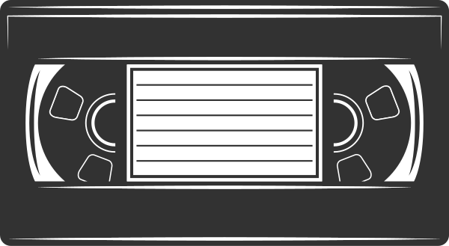
METHODOLOGY
SIGNAL CHAIN
SDI TSG
(Phabrix Sx TAG)
SDI -> S-Video Converter
AJA FS1
S-VHS Deck
Sony SVO 5800
SDI
S-Video
Notes:
To create the video files, I started by recording an SVHS and VHS tape. I did this by generating test signals, converting the signals from SDI to S-Video using an AJA FS1, and then recording the S-Video signal using a Sony SVO 5800 SVHS VTR.

Slide 26

METHODOLOGY
SIGNAL CHAIN
Composite
Capture Device
SAMMA Solo
S-VHS Deck
Sony SV0 5800
S-Video
Composite
S-Video
Composite
VHS Deck
JVC HR-VP690U
Composite
SDI TSG
SDI
Notes:
I then played back each tape using both an SVHS deck and VHS deck. I captured them with one of our SAMMA Solo video encoders using both Composite and S-Video from the SVHS deck, and Composite from the VHS deck. I also captured the Test Signals from the signal generator using SDI directly.
All these different playback methods were captured to JPEG2000 MXF files.

Slide 27
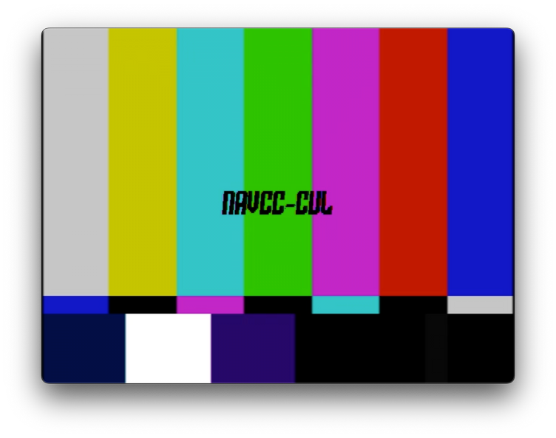
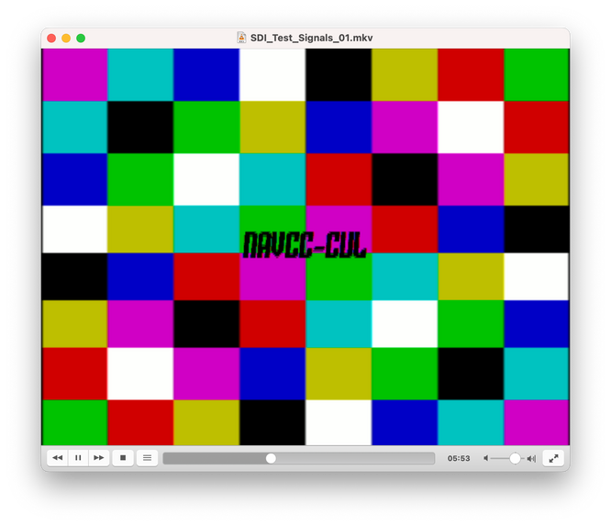
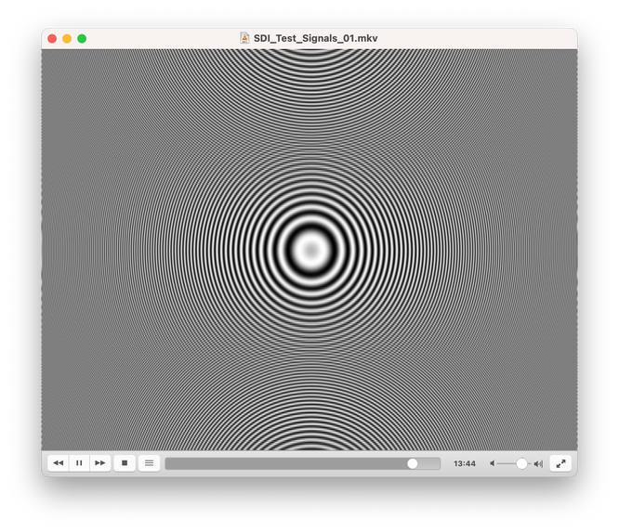
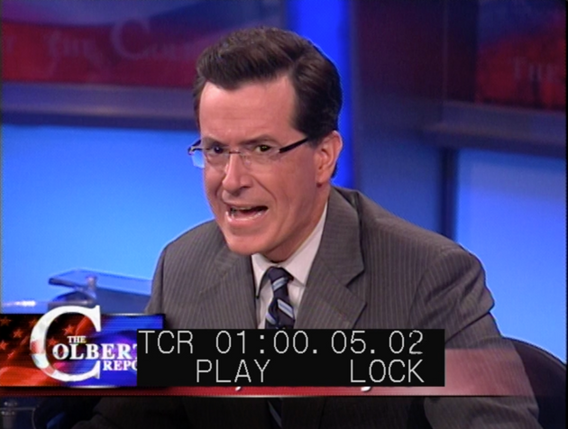
METHODOLOGY
TEST SIGNALS
SMPTE Bars
Tartan Bars
Multiburst
Zone Plate
Content
Notes:
Here are the test signals that were captured.
Standard SMPTE bar
Tartan bars so that we could see dot crawl errors
Multiburst and Zone plate so we could test resolution and see cross color errors
And we also recorded some television content

Slide 28
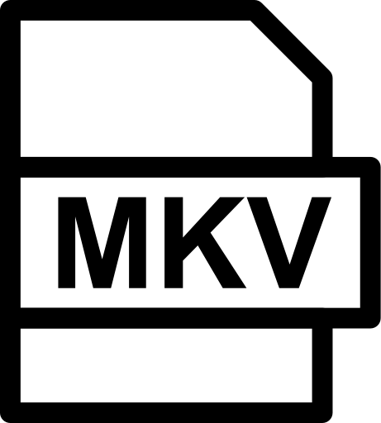
METHODOLOGY
VISUAL INSPECTION
FFmpeg
weave=first_field=top
720x243
59.94 fps
720x486
29.97 fps
Notes:
The first step I took was to transcode the MXF files to FFV1/MKV. This made further processing simpler, since FFmpeg has an easier time decoding FFv1.
As an aside, the weave filter was used to turn the field-organized SAMMA files to the frame-organized MKV files.
You can learn more about this in Dave Rice and Jim Leonard's talk on this topic at 11am on Friday

Slide 29


METHODOLOGY
VISUAL INSPECTION
H.264
crf 14
FFmpeg
ProRes
422 HQ
Notes:
Next, I created H.264 MP4 files using a constant rate factor of 14, and ProRes 422 HQ files.
I didn't end up using the H.264 files for much (I can discuss my plan in more detail if there's time).
The ProRes files were used for visual inspection and composing.

Slide 30


METHODOLOGY
DATA INSPECTION
FFmpeg
crop:720:466:0:10,
pad:720:486:0:10:black
Average Packet Size
for file in *.xml ; do cat "$file" | grep pkt_size | grep video | cut -d '"' -f 16 > "${file%.*}_pkt_size.csv"; done
Average SAT MAX
for file in *.xml ; do cat "$file" | grep SATMAX | cut -d '"' -f 4 | cut -d '.' -f 1 > "${file%.*}_SATMAX.csv" ; done
Notes:
The MKV files were used for data inspection. First, I cropped 10 pixels off the top and bottom of the content so that headswitching noise wouldn't throw the tests off.
Then, I used QCTool to create XML reports, then ran the following bash commands to calculate the average packet size and average Max Saturation values.
QCTools data in XML format is very easy to read and parse! You can use these commands gather any info you want very easily, I highly suggest it!

Slide 31
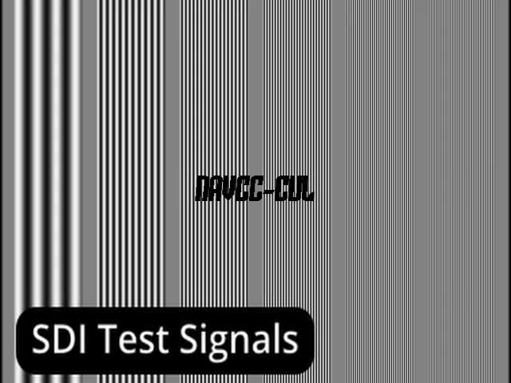
RESULTS: MULTIBURST

Slide 32
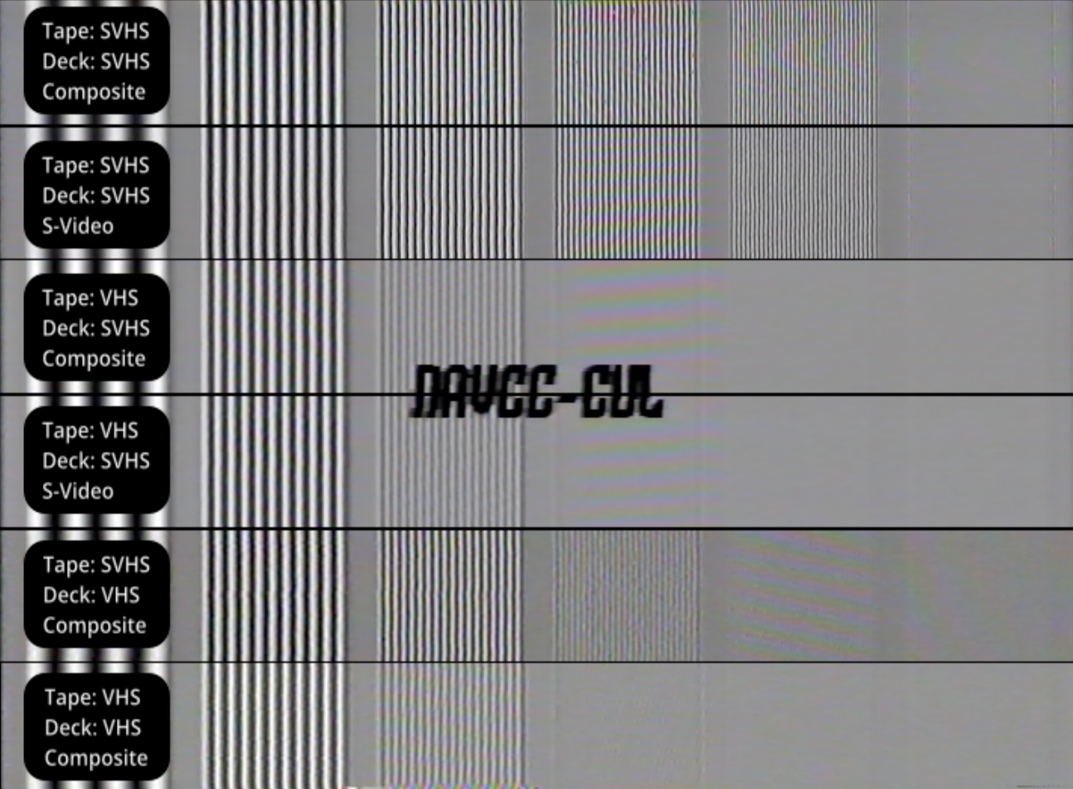
RESULTS: MULTIBURST
Details lost entirely on VHS tape
VHS deck able to get some extra details from an SVHS tape
Notes:
Here's what the multiburst results looked like.
You can see immediately that the resolution of SVHS vastly outmatches the resolution of VHS, even if the SVHS tapes are played back on an VHS deck!
You can also see an improvement in cross-color errors when using S-Video transmission. However this is far more obvious in the next example:

Slide 33
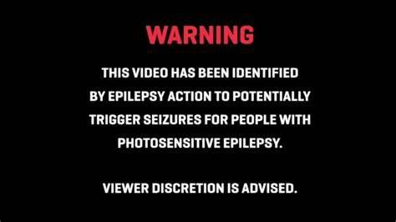
Notes:
Before we move on, I want to warn the audience that the next slide has flashing lights which may be harmful to those with photosensitivity.

Slide 34

RESULTS: ZONE PLATE

Slide 35
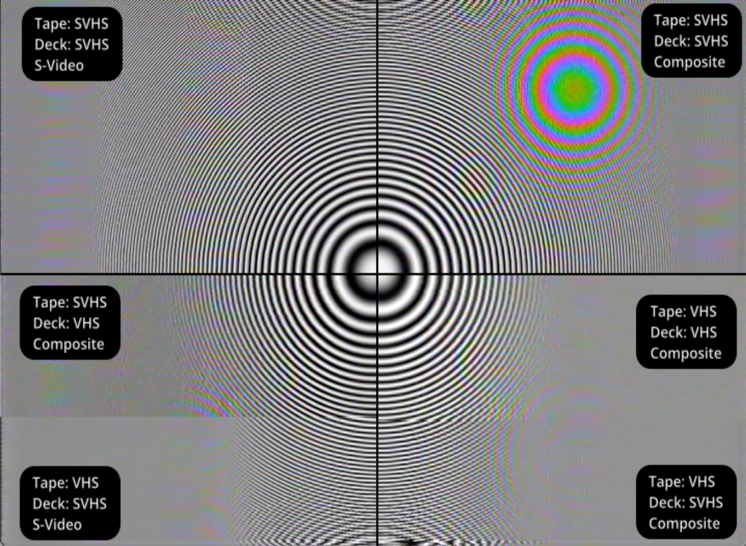
RESULTS: ZONE PLATE
Significant Cross color errors when using composite
Notes:
The zone plate!
Here you can see very clearly that the cross color errors are significantly reduced when using S-Video transmission. This is especially apparent on the SVHS tape, which has so much more detail than the VHS tape, and thus more opportunity for high frequency luma detail to leak into the chroma information.

Slide 36
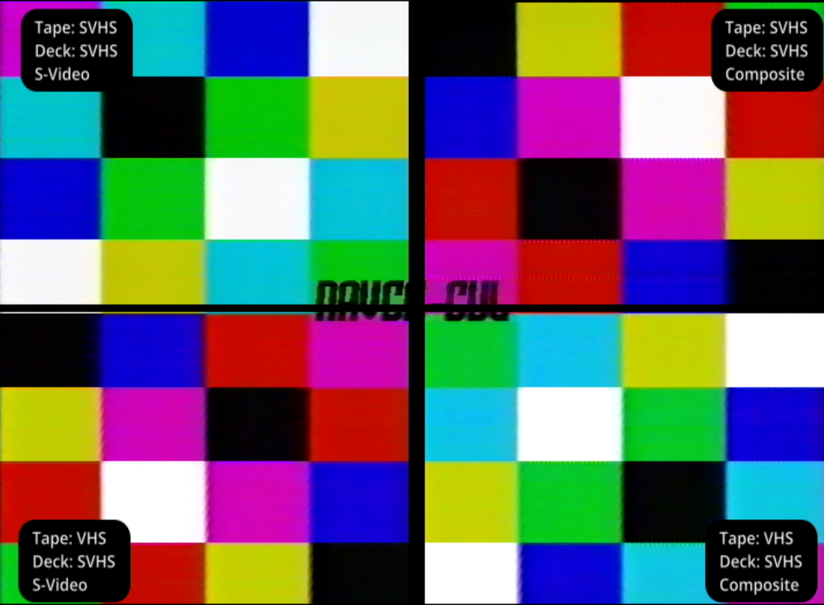
RESULTS: TARTAN BARS
Notes:
The tartan bar results can be a little hard to see, but if we zoom in...

Slide 37
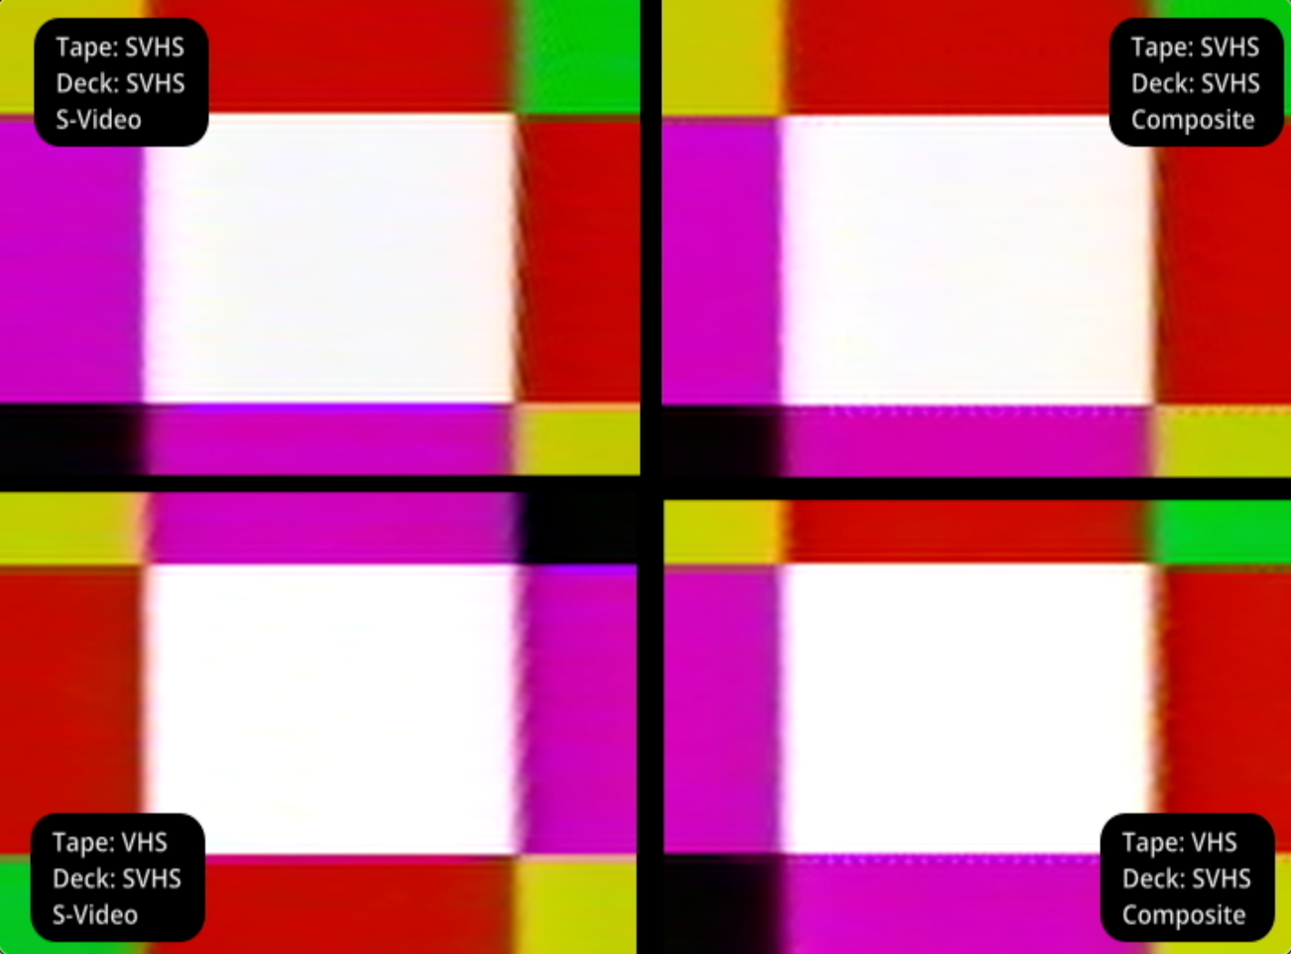
RESULTS: TARTAN BARS
Dot-crawl visible in composite transmission of both VHS and SVHS
Notes:
you can see Dot-crawl visible in composite transmission of both VHS and SVHS

Slide 38
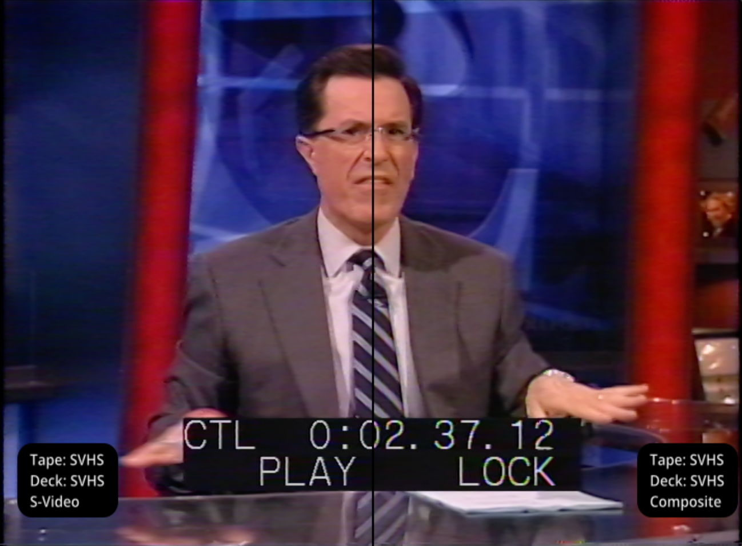
RESULTS: CONTENT
SVHS: S-Video
vs
SVHS: Composite
Cross Color in tight details
Notes:
Now taking a look at the actual content, this image compares the SVHS tape captured SVHS, using S-Video on the left and Composite on the right. The biggest difference is the cross color artifacts on the tight pattens on his tie, and the superimposed text

Slide 39
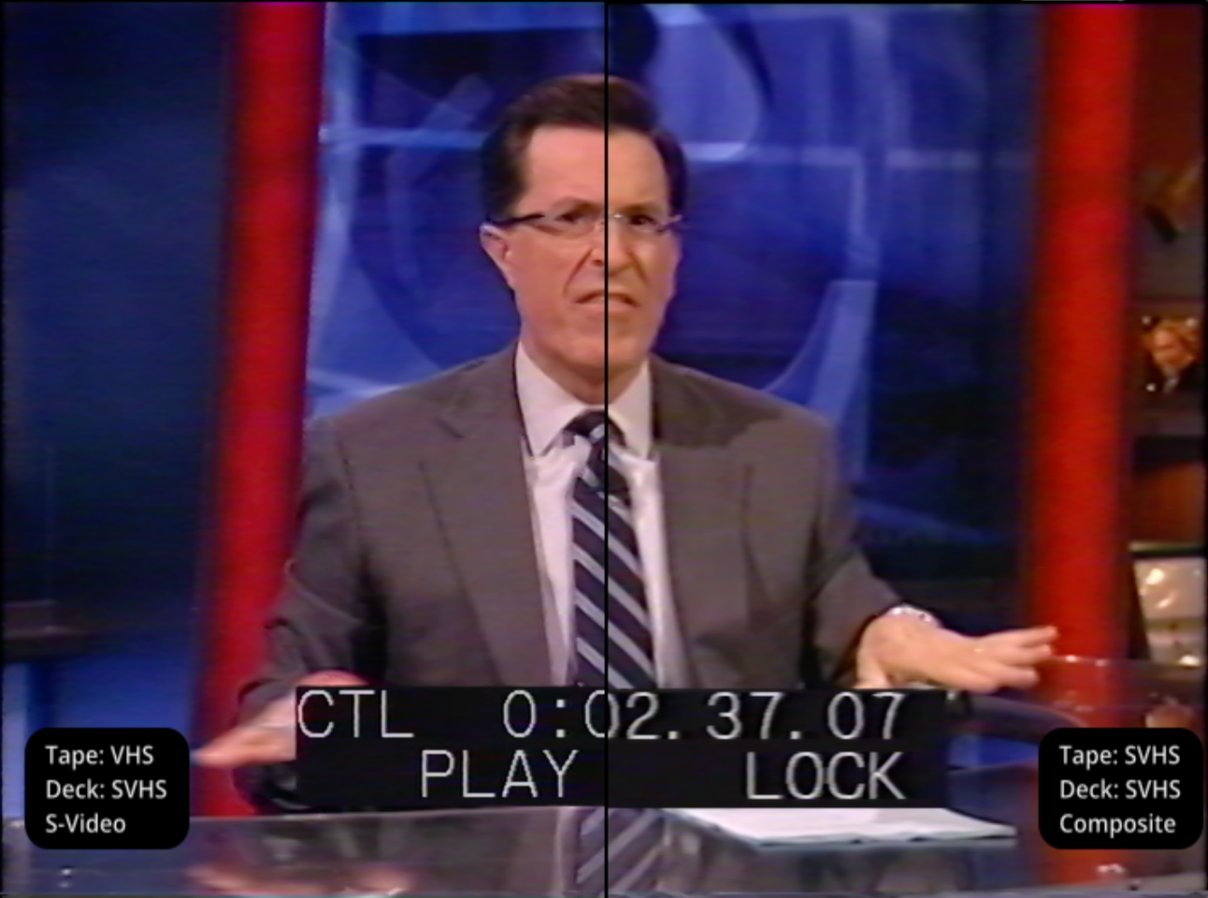
RESULTS: CONTENT
SVHS: S-Video
vs
VHS: Composite
Lost detail, image is blurry
No cross color in superimposed text
Notes:
If we then compare the same SVHS S-video transfer to the VHS Composite transfer you can see a significant loss of quality in the tie and the superimposed text. However, interestingly enough the resulting loss of resolution also removes the cross color artifacts in the superimposed text, which were visible in the SVHS composite transfer.

Slide 40
RESULTS: DATA
RECORDING | SDI | SVHS | SVHS | VHS | VHS | SVHS | VHS
PLAYBACK | N/A | SHVS | SVHS | SVHS | SVHS | VHS | VHS
TRANSMISSION | SDI | Comp | S-Video | Comp | S-Video | Comp | Comp
MULTIBURST SAT MAX | 2 | 146 | 80 | 60 | 68 | 105 | 76.7
ZONEPLATE SAT MAX | 2 | 445 | 102 | 156 | 82 | 328 | 237
CONTENT SAT MAX | 314 | 308 | 304 | 310 | 316 | 293 | 290
MB PACKET SIZE | 9969 | 480234 | 427413 | 356887 | 335185 | 468598 | 403388
ZP PACKET SIZE | 426591 | 641312 | 533859 | 428285 | 378757 | 555583 | 473971
CONTENT PKT SIZE | 392853 | 352949 | 334004 | 337335 | 328166 | 419224 | 363676
Notes:
For the data portion I gathered the Max Saturation and Packet Size for the different test signals, as well as the television content.
It's a little harder to see in this format, so let's see some graphs

Slide 41
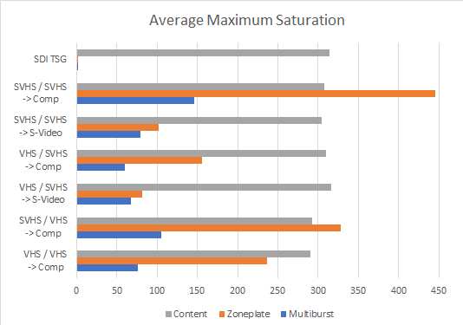
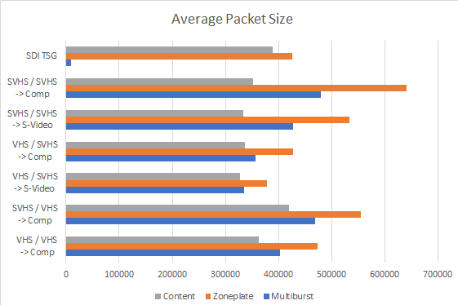
RESULTS: DATA
Notes:
In these graphs each color represents a type of signal, either television content, zoneplate, multiburst.
The left graph is the average max saturation, and the right is the average packet size.

Slide 42
RESULTS: DATA
S-Video significantly reduces cross-color errors for SVHS tapes
Notes:
The graphs show that S-Video significantly reduces cross-color errors for SVHS tapes.
This is especially true for the SVHS recording of the Zone Plate test signal, which has a LOT of details which cause cross color.

Slide 43
RESULTS: DATA
S-Video reduced errors for VHS zone plate...
but slightly increased errors in the multiburst
Notes:
One unexpected result is that using S-Video reduced errors for the VHS zone plate recording, but slightly increased the VHS multiburst recording.
This is a bit troubling, as we suggests that the amount of cross color errors mitigated by s-video may change depending on how detailed the video content is.

Slide 44
RESULTS: DATA
SVHS recording offers significantly more detail...
over VHS recordings
Even if played back on an VHS deck
Notes:
Looking at the avrage packet size, we can see that SVHS recordings have far more detail than VHS recordings, even if played back on a VHS deck.

Slide 45
ANALYSIS
S-VHS offers significantly more detail over VHS, even if the playback deck is VHS
S-Video reduces dot crawl errors for SVHS and VHS tapes
S-Video significantly reduces cross-color errors for SVHS tapes
S-Video may increase cross color errors for VHS tapes depending on the complexity and detail of the recorded content
Notes:
I'd like to say that I could spend more time analyzing this data and doing more tests like this, but in the time I had with this I came to the following conclusions.
SVHS offers significantly more detail over VHS, even if the playback deck is VHS. Of course, playing an SVHS tape on a VHS deck leads to a significant loss of detail that was originally recorded on the tape
S-Video reduces dot crawl errors for SVHS and VHS tapes
S-Video significantly reduces cross-color errors for SVHS tapes
S-Video may increase cross color errors for VHS tapes depending on the complexity and detail of the recorded content

Slide 46

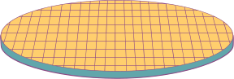

PART 3
APPLYING IN A PRESERVATON CONTEXT
Notes:
And now, for applying this to our work in preservation!

Slide 47
RECOMMENDATIONS
Use S-VHS decks to transfer both S-VHS and VHS Tapes
Use S-Video to transfer S-VHS tapes
I cannot make a recommendation for whether to use S-Video or Composite VHS tapes
Notes:
If I had to make any recommendations or best practices based off this data I would say:
Always use an SVHS deck to transfer SVHS and VHS tapes. Especially SVHS.
I suggest always using S-video to transfer SVHS tapes. This will reduce dot crawl, and to avoid cross color errors caused by the additional details contained in SVHS content.
It's worth noting that with the data collected I cannot make a recommentation for whether to use S-Video or Composite when using an SVHS deck to trasnfer a VHS tape.
The data shows that using S-Video to transfer VHS tapes on an SVHS deck may introduce cross color errors, but this may outweigh cross luma errors which are entirely mitigated using S-Video

Slide 48
CHALLENGES
Equipment common in preservation labs does not support S-Video
Blackmagic UltraStudio
DPS 575
Equipment that does support S-Video is expensive. How do we prioritize our budgets?
AJA FS2
BrightEyes75
Adding more processing in signal chains adds more opportunities for error
Notes:
While it's easy enough for me to stand up hear and proselytize for S-Video in preservation signal chains, I understand fully the complexity of doing so in some cases.
Lots of equipment common in preservation labs does not support S-Video. BlackMagic ultrastudio equipment doesn't support S-Video at all, and the DPS-575 has errors decoding S-Video.
There is equipment out there that properly supports S-Video, like the AJA FS series and BrightEyes75, but these can get pretty expensive. However, if there is equipment or decks that can do a better job or preserving our collections we need to figure out how to prioritize our budgets and equipment purchases
Additionally, adding more points of processing in your signal chain adds more opportunities for error. If you do add equipment, always make sure to qualify your stations!

Slide 49
NEXT STEPS
Rerun the experiment focusing on different types of content
Find other QCTools parameters to use as data points
Experiment with U-matic Dub output
Further experimentation with 3D comb filters and tunable notch/bandpass filters
Notes:
And lastly, I'd like to talk about the next steps. I had fun running these experiments, but feel like I only scratched the surface. I've been interested in building out the NAVCC Video Lab testing infrastructure so that we do more technical investigation of this type.
Some ways to expand this work would be to run the experiment again, but focus more on programmatic content rather than test patterns
I could also spend time to find more useful data points from QCTools, One option would be to separate the color channels and doing specific analysis of those channels.
We could also perform similar tests U-matic and U-matic SP, along with the color-separated Dub output.
Lastly, we could experiment with types of filters that can improve color separation, such as 3D Comb Filters and tunable notch and bandpass filters

Slide 50
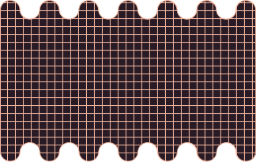




THANK YOU!
Notes:
And that's all I've got, any questions?!

